Slide 1
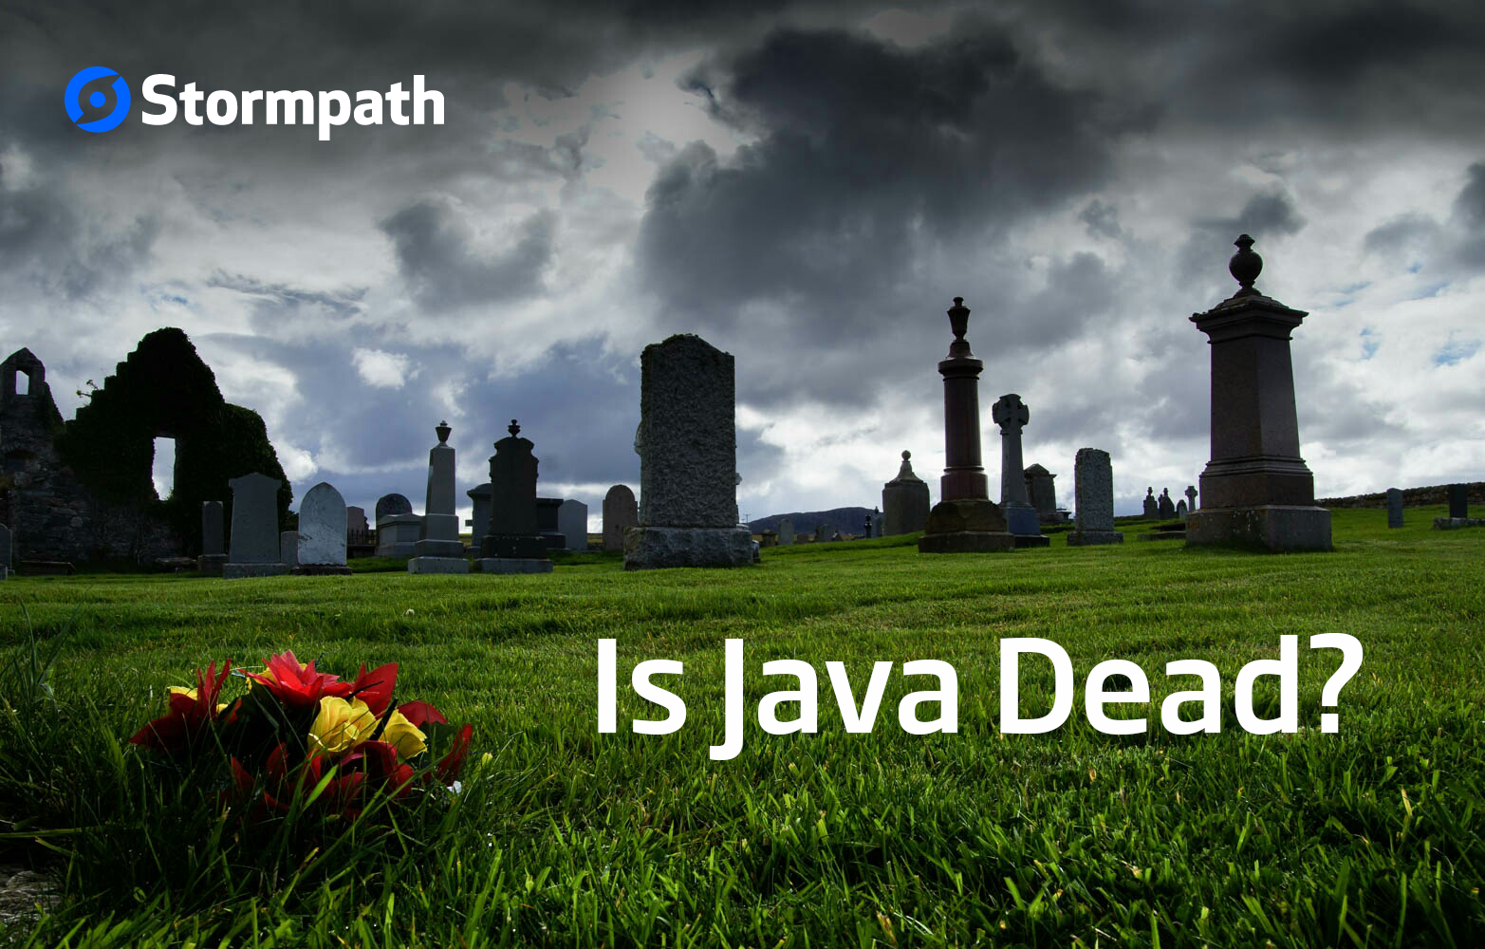
By RATOMBOTIANA Armand Judicael
IT INFRASTRUCTURE , Java Developer, DMSA

Slide 2


THIS PRESENTATION IS FOR OUR FRIEND WILLY(25 YEAR)

Slide 3
PRESENTATION
Arguments against java
Demo ( Jshell and JAVAFX )
It take only 30 min
Questions at the end

Slide 4
Arguments against Java
Java is dead because google switch to kotlin after the war againts oracle about the java api
Java is slow
Java is outdated technology
Java is verbose

Slide 5
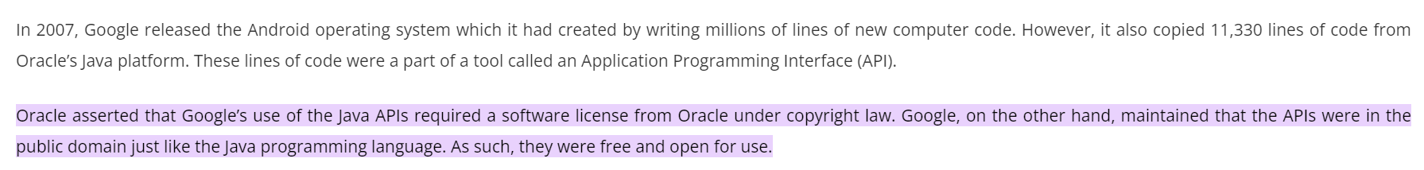
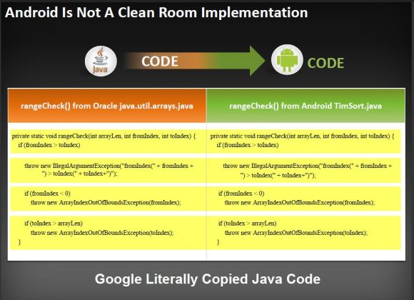
The Java Wars: Oracle vs Google The Supreme Court Finally Decides in Favor of Google
www.dmca.com/articles/oracle-vs-google-the-java-wars
Oracle vs. Google: Who owns the Java APIs? | InfoWorld
Stanford Seminar - Oracle v. Google: Are Java APIs Copyrightable? - YouTube

Slide 6
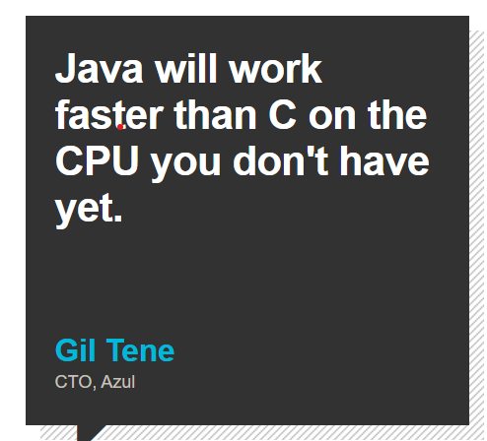
JAVA IS SLOW
Java was slow before JIT compilation ( java 1.2 / java 1.3 ) but these days java can be compiled to a native machine code using GRAALVM.
(30) Revolutionizing Java-Based Applications with GraalVM by Alina Yurenko and Thomas Wuerthinger – YouTube
Simple Java Stream Benchmark (graalvm.org)

Slide 7
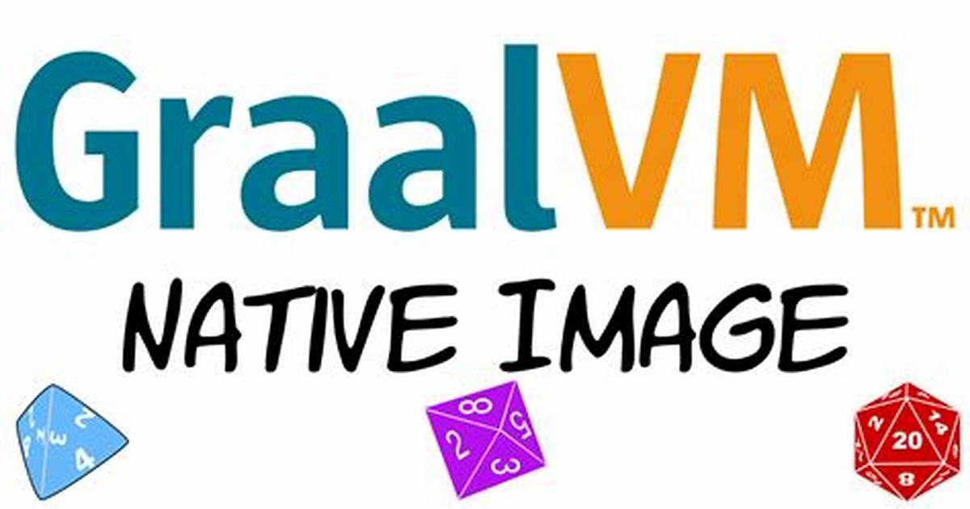

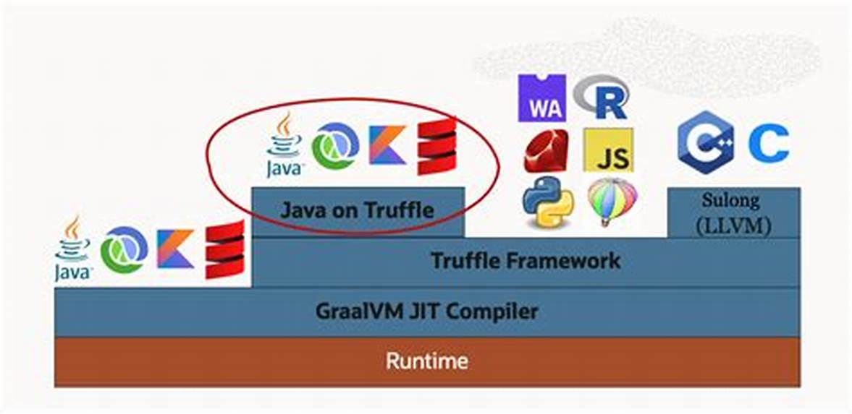

JAVA PERFORMANCE IMPROVEMENT

Slide 8
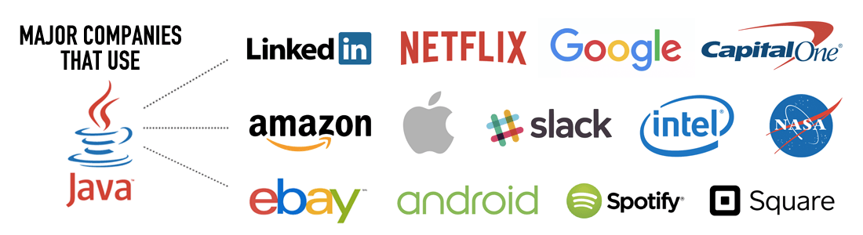
JAVA IS OUTDATED TECHNOLOGY
Java is a general-purpose programming language designed by Sun Microsystems in 1995 ( 27 year ) and it still used by big companies as their primary language .

Slide 9
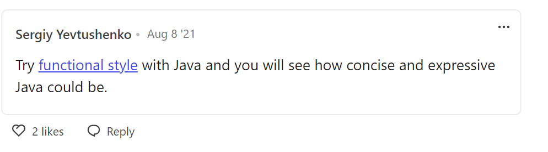
JAVA IS VERBOSE
Yes , java was verbose before we introduce functional programming (Lambda expression) in java 8 in 2014.
In recent releases ( switch expressions in java 14 , pattern matching and records in java 17 ).
We can use JVM languages like Kotlin , Groovy and Scala

Slide 10
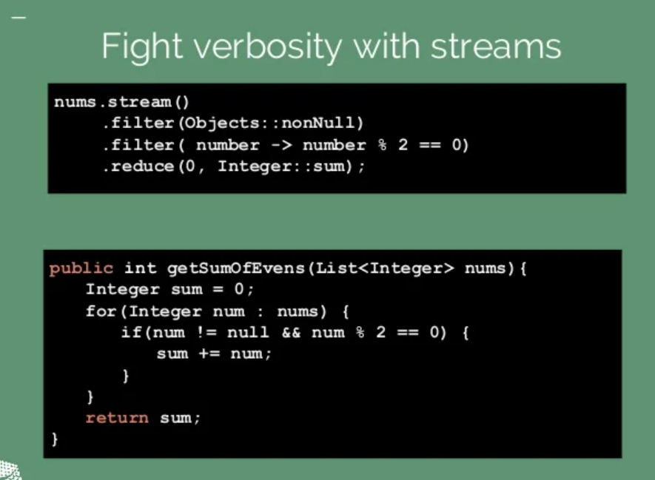
FUNCTIONNAL PROGRAMMING IN JAVA

Slide 11
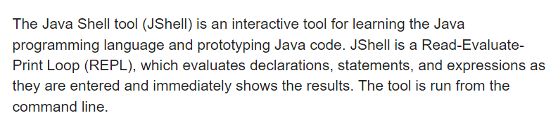
DEMO
Install java 9 or Higher (jshell only)
I recommend to install jdk bundled with JAVAFX package
Download link : foojay – a place for friends of OpenJDK

